Slide 1
Rental Management System
Presented By:
Rahul Balakrishna-002833716
Preeti Kulkarni-002296910
Monica Sriramreddy-002641657
Durga Sreshta Kamani-002885939

Slide 2
Main Aim:
The objective of the project is to rent vehicles and electronics to the customer, in our project the vehicles are cars and bikes, and the electronics are laptops and phones.
The system admin is a role that can create accounts for other roles. The customer can create his account and log in to the application to rent the enterprises. At a time the customer cannot make another booking from a single enterprise, the respective enterprise admin will update the available items and then can approve or deny the booking made by the customer and can also charge a late fee if the return date exceeds. The customer can file a complaint for the issues he had with the items. The requests will then return to the respective admins and they will assign the mechanics or technicians depending upon their complaint. The mechanic or Technician solves the issue and updates its status.

Slide 3
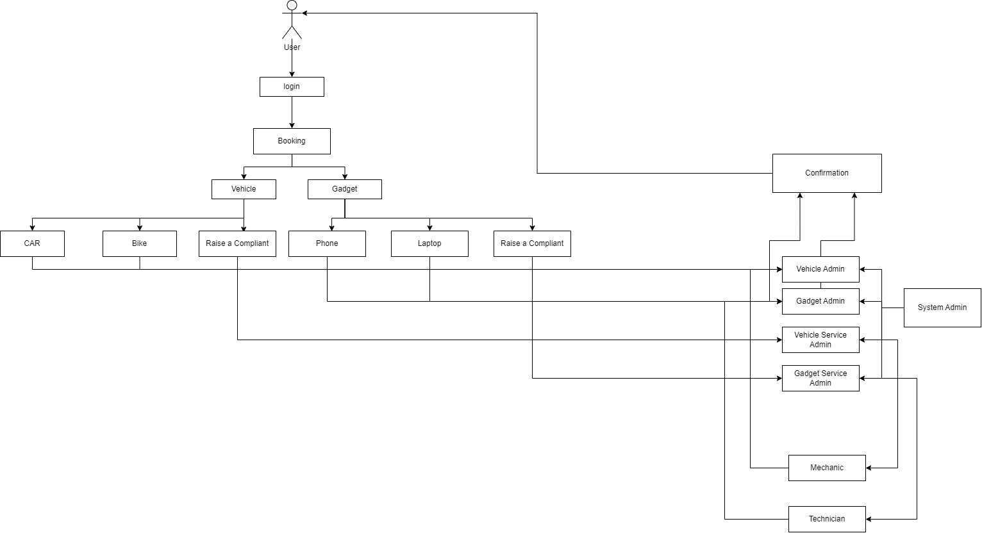
Architecture:

Slide 4
StakeHolders:
System Admin: Account creation for other roles.
Enterprise Admin: This admin will be Managing available items, approves/denies bookings, and handles customer complaints.
Customer: Creates an account, rents items like phone,laptop,car,bike and files complaints.
Mechanic/Technician: Resolves customer complaints, updates status.

Slide 5
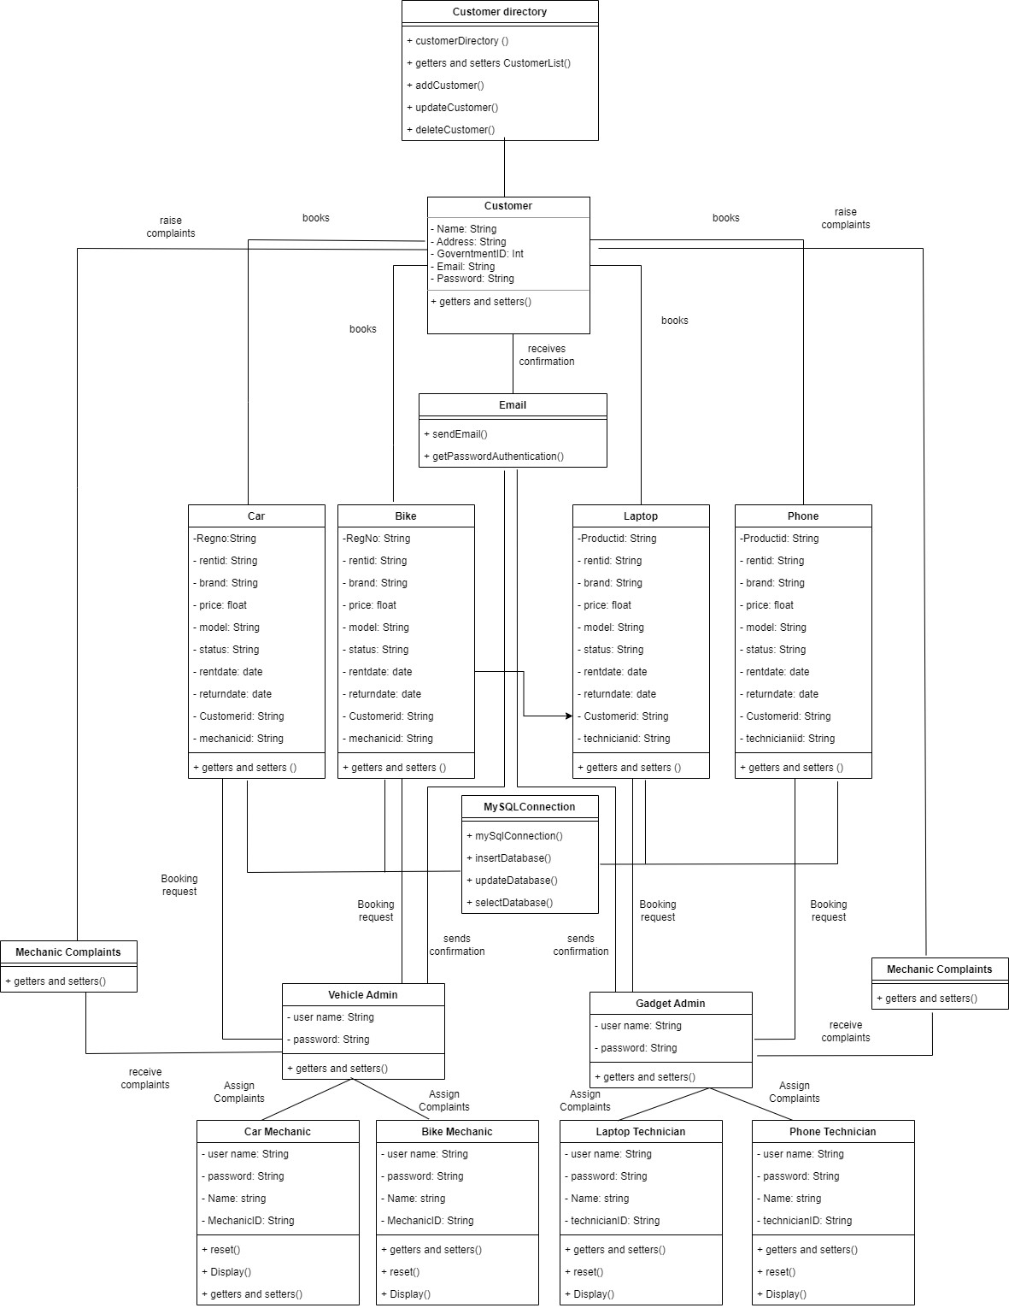
Class Diagram:

Slide 6
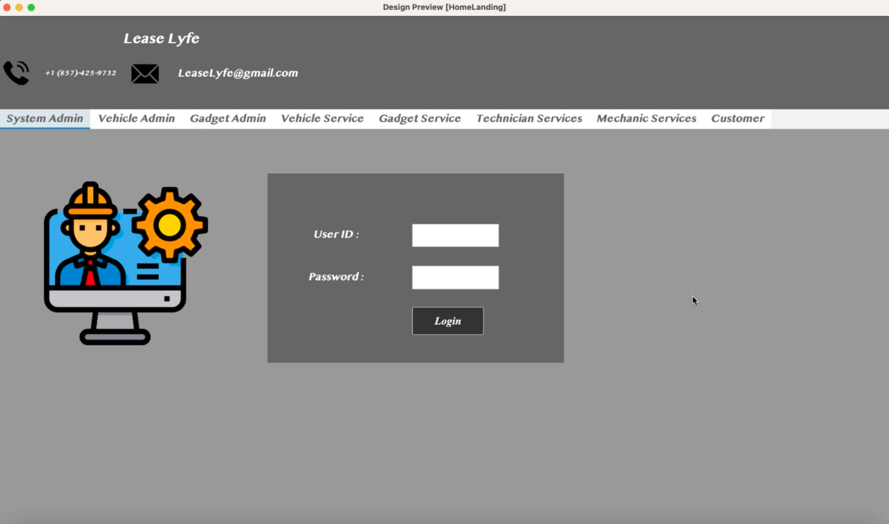
Login in :

Slide 7
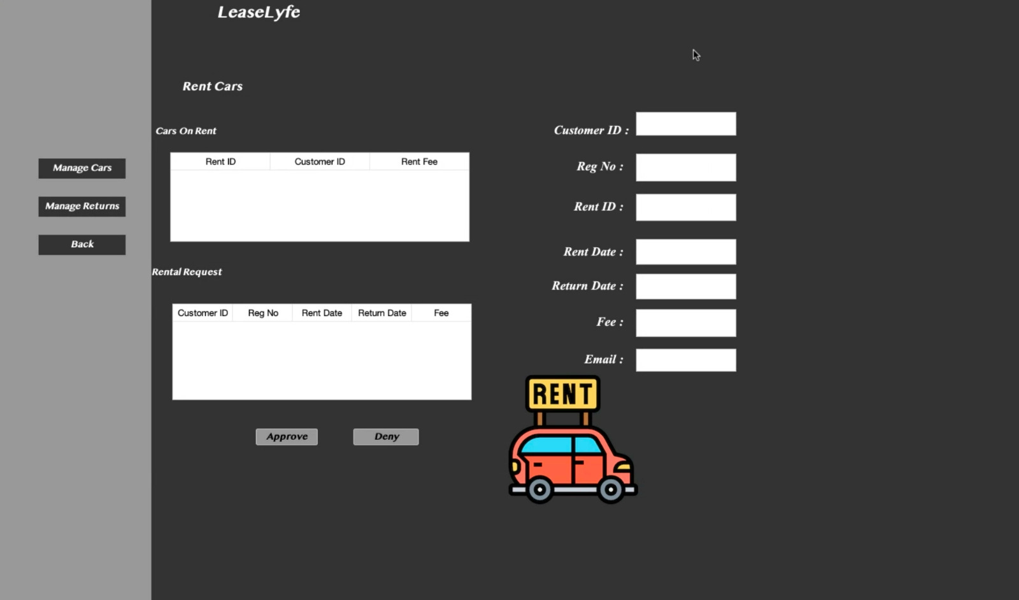
Rent car:

Slide 8
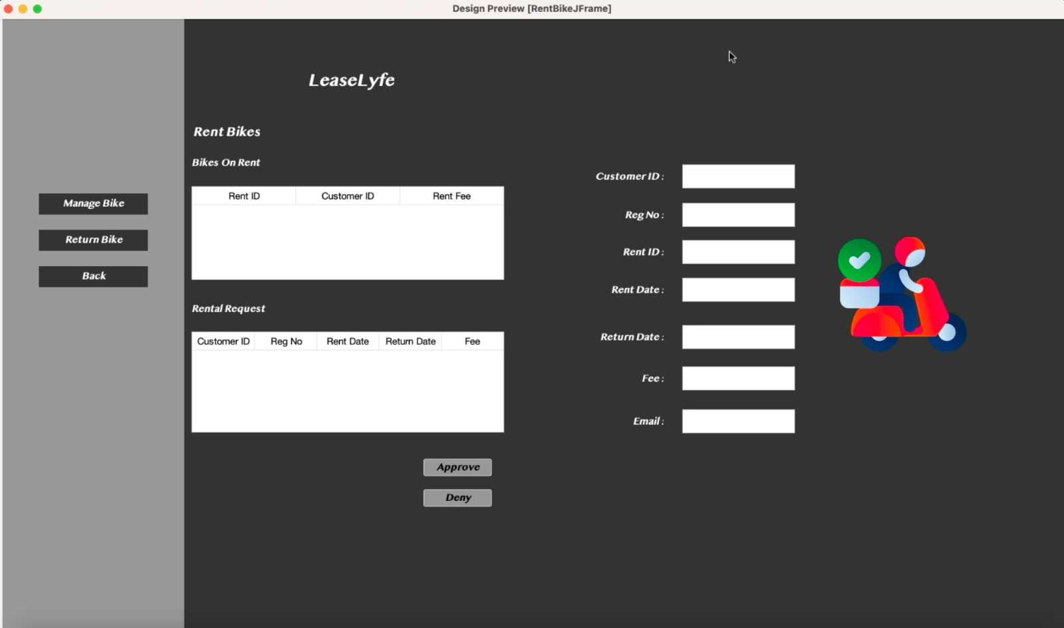
Rent Bike:

Slide 9
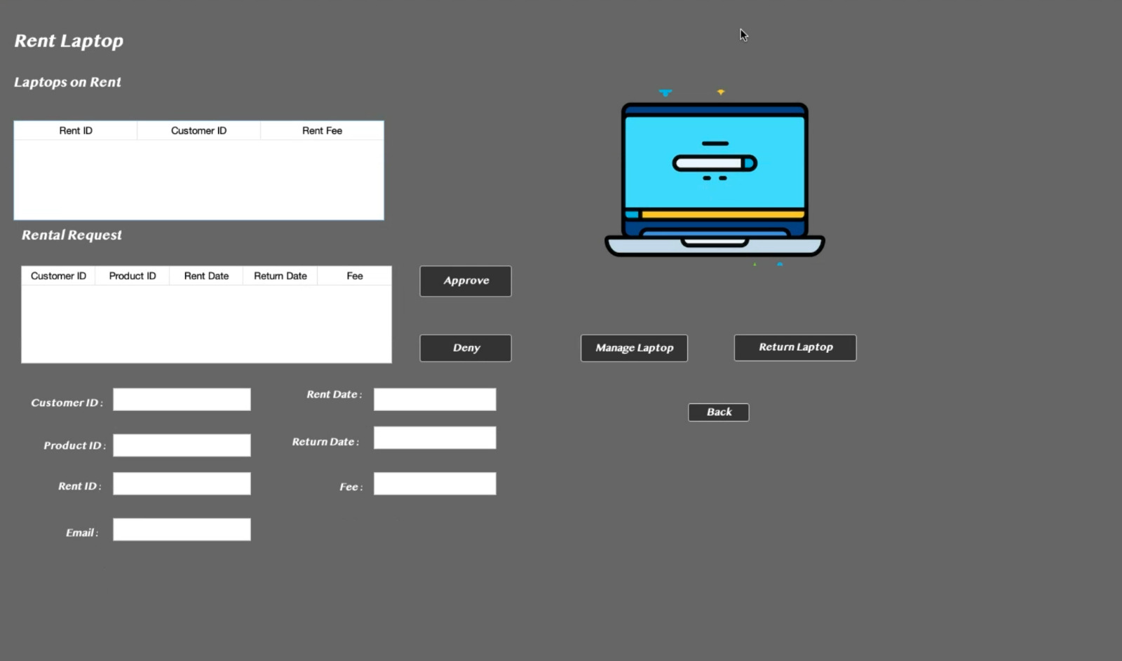
Rent Laptop:

Slide 10
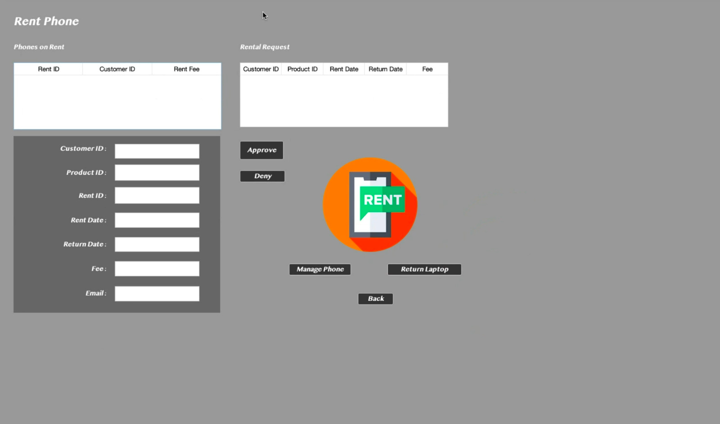
Rent Mobile

Slide 11
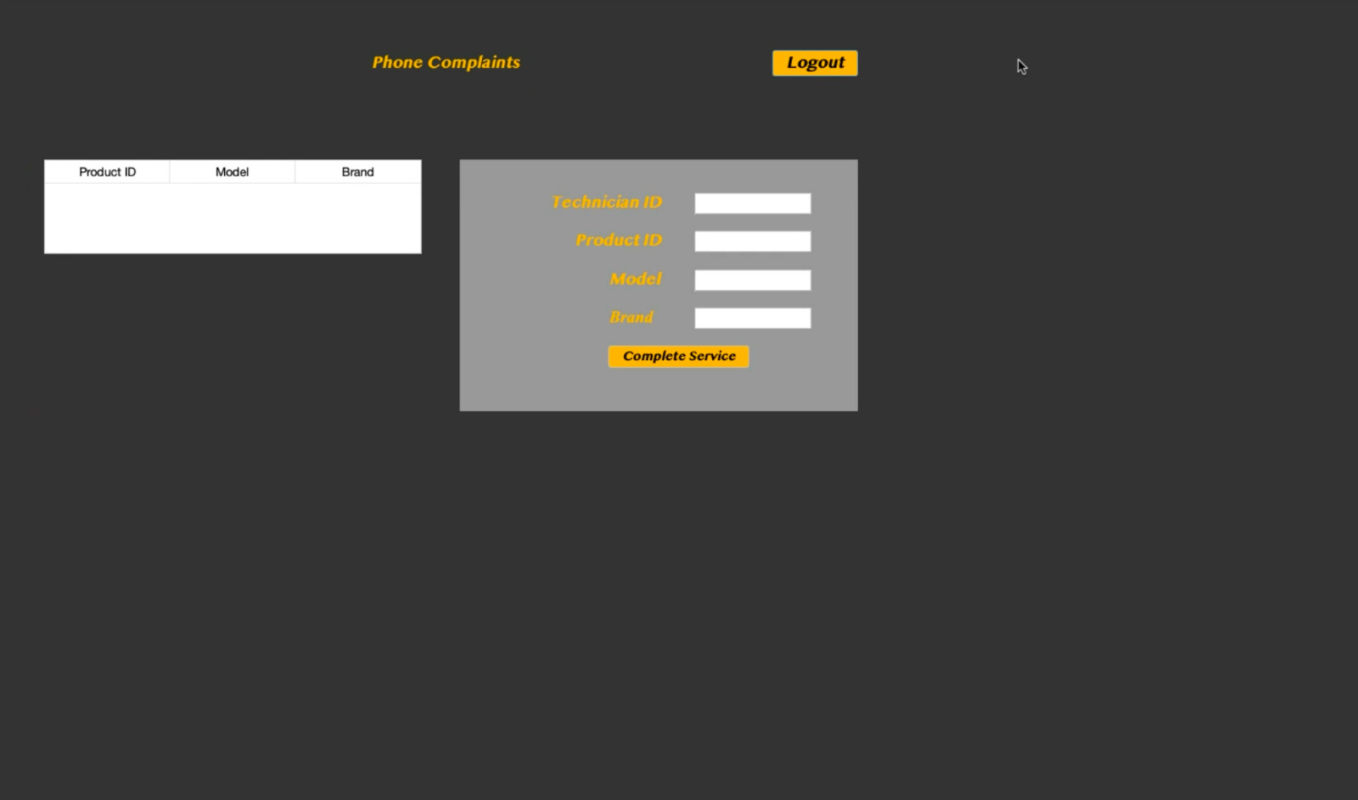
Phone Complaint

Slide 12
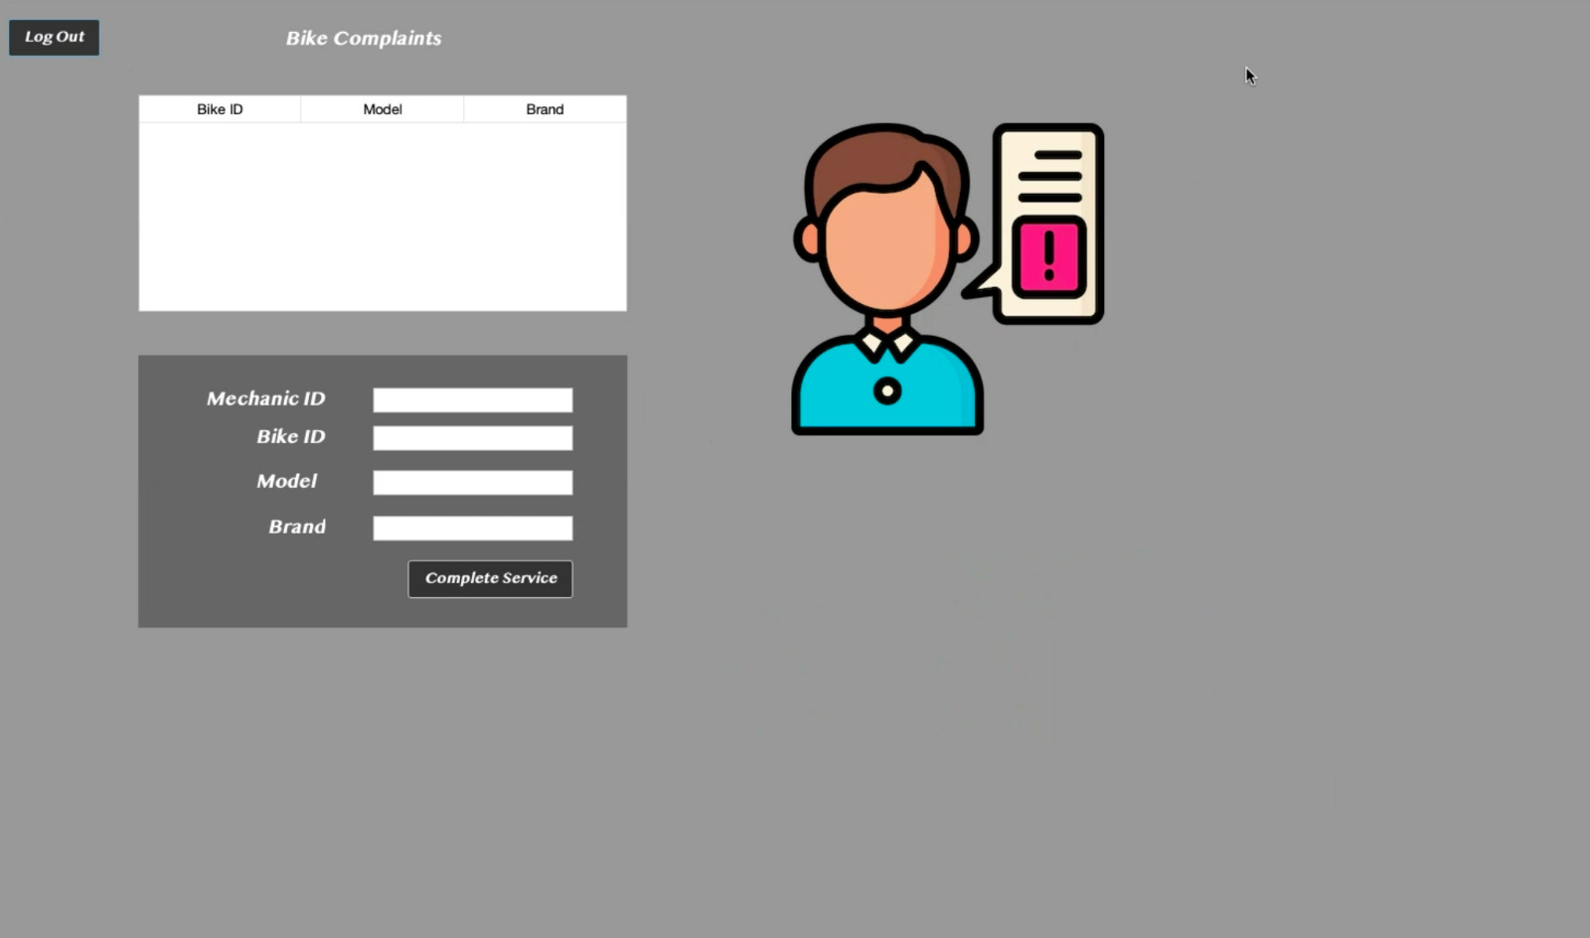
Bike Complaints

Slide 13
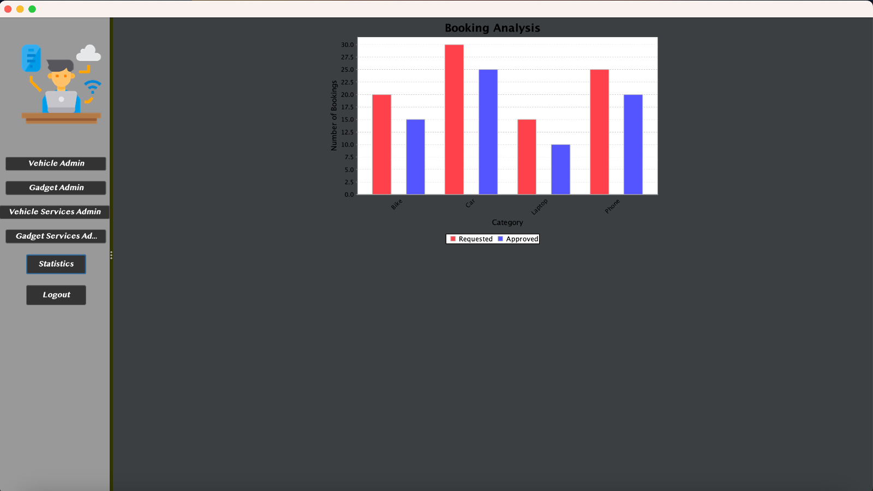
Analysis:

Slide 14


